Slide 1

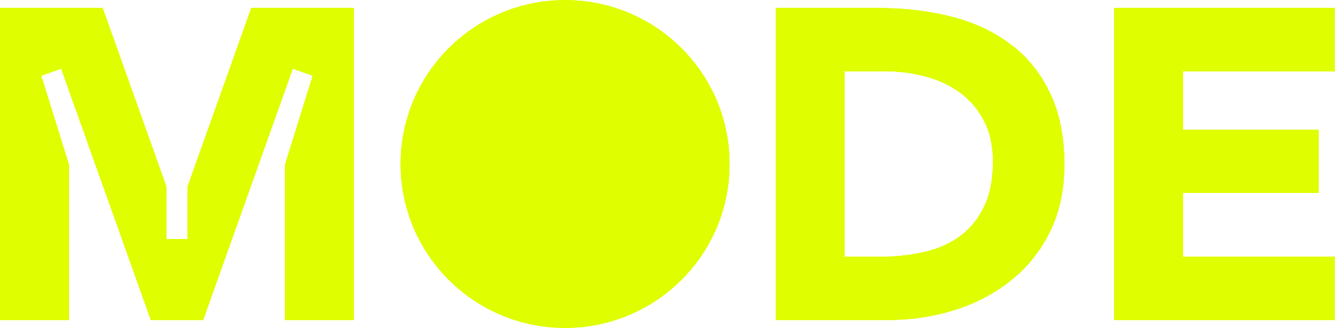
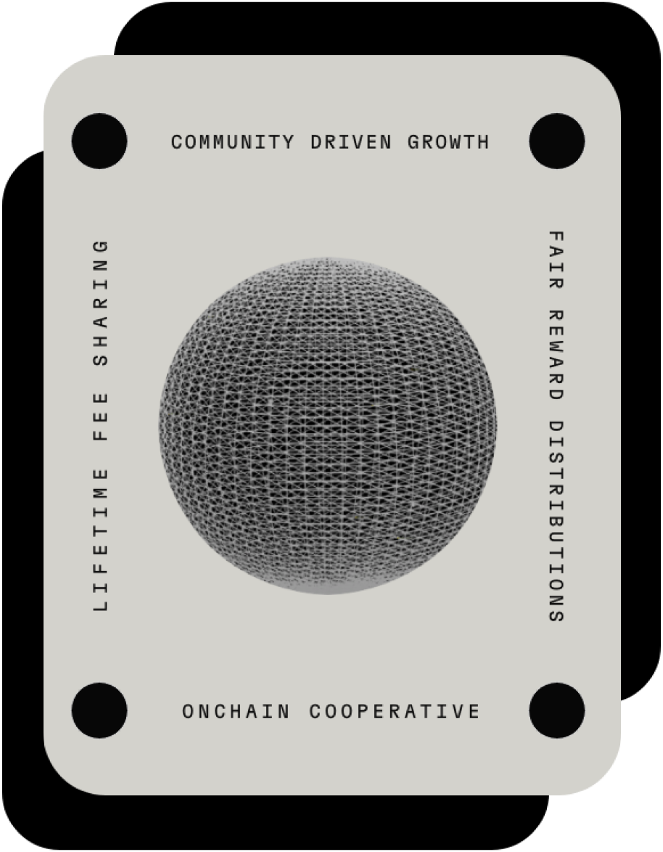
Score
Unlock Your DeFi Potential!

Slide 2






Meet the Team!
Miguel Mendez
Ethan Cala
Damien Beltran
PM and Full Stack (Solidity, React, JS)
Frontend + Java, Python, C#, JS
Frontend + JS, React, Java
Emengkeng Juslen Kenmini
Skyer Hollingsworth
Backend + Solidity, C, Typescript, Java, Python
Frontend + JS, React

Slide 3


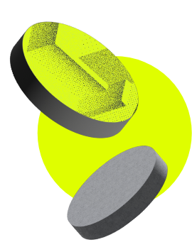



The Problem
People with digital assets often aren't using them to their full potential, especially if those assets are spread across different platforms. This makes it hard to keep track of everything, manage risk, and make good investment decisions. But most importantly, it makes it difficult for users who are particularly new to defi, unaware of how much more efficient they could be with their digital assets.

Slide 4

The Solution
Consolidate users' assets from all ecosystems into a user-friendly interface, and suggest investment opportunities for this idle capital, such as Mode staking, Yield Farming or other options.

Slide 5
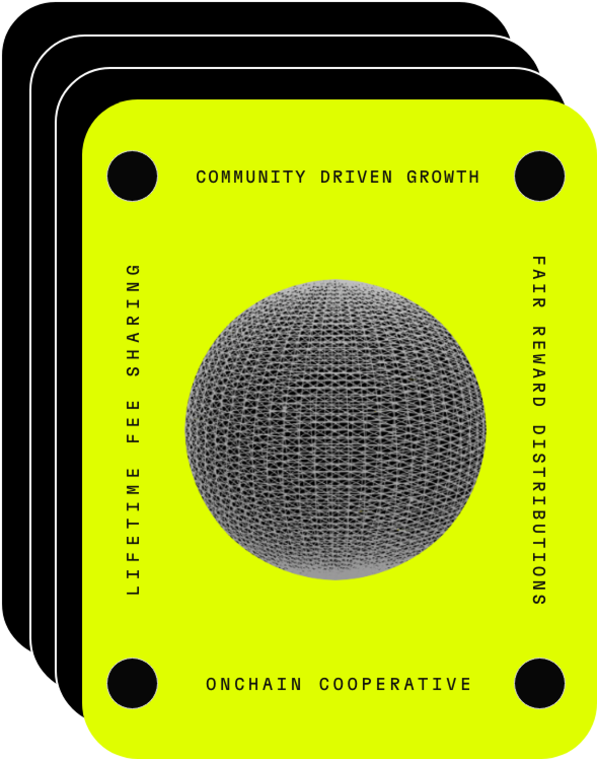

What is Mode Score?
Introducing Mode Score, a dApp where you can connect your wallet and receive a score that reflects your capital efficiency on multiple ecosystems. Alongside your score, we will provide personalized recommendations on how to optimize your portfolio for greater capital efficiency.

Slide 6
Benefits
01
02
03
04
Enhanced Capital Efficiency
User-Friendly Interface with Multiple Ecosystems
Helps inexperienced Users
Risk Management

Slide 7


The Milestones/Features
Connect to Wallet
Capital Efficiency Scoring
Personalized Investment Recommendations
...all while presenting the user’s multi-ecosystem portfolio in a friendly UI!

Slide 8
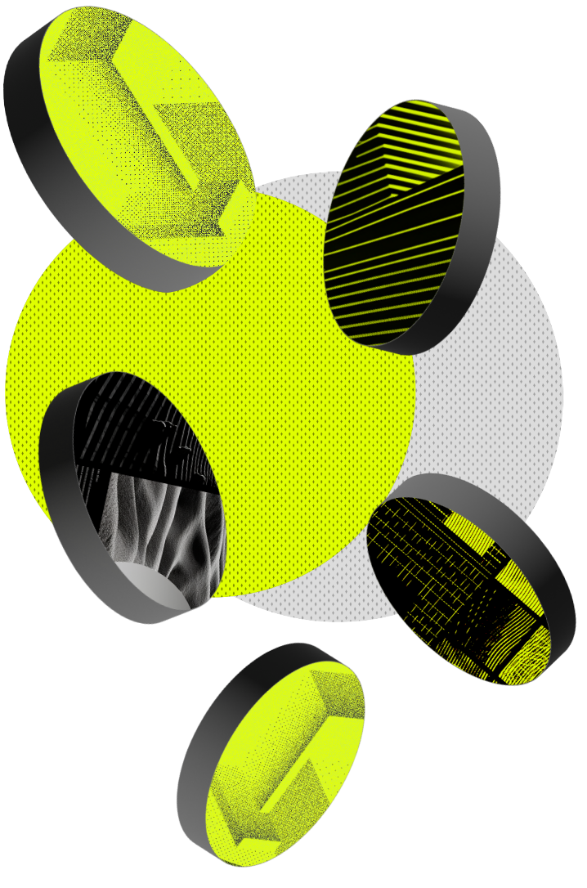
Conclusion
Mode Score is a dApp that evaluates and optimizes your digital assets across multiple ecosystems with a capital efficiency score, and a user-friendly interface. It integrates wallets, recommends opportunities, and is especially helpful for newcomers to DeFi.

